Slide 1
Natural Language Understanding
Few Shot Learning
Task-Aware Representation of Sentences for Generic Text Classification
Transfer Learning
Multi Task Learning

Slide 2
Analogy
01
Can we use transfer learning with new tasks without retraining?
Can we use one Solution to tackle many tasks?
How we can deal with data scarcity?
02
03
Is it possible to build classifier for non observed class, zero-sample for each class ?
Is it possible to build classification task for just few examples of each class?
06
Can we add new classes without retrain the model, and classify them successfully ?
05
04
Topic Modelling
Sentiment Analysis
Sports or Politics...etc
Is it pos/neg
Yes
Liverpool performed very well in the last match, and Mo-Salah Scored 3 goals.
sentence or Question
Sentence Classification
Joyful or nervous ..etc
Emotion Detection

Slide 3
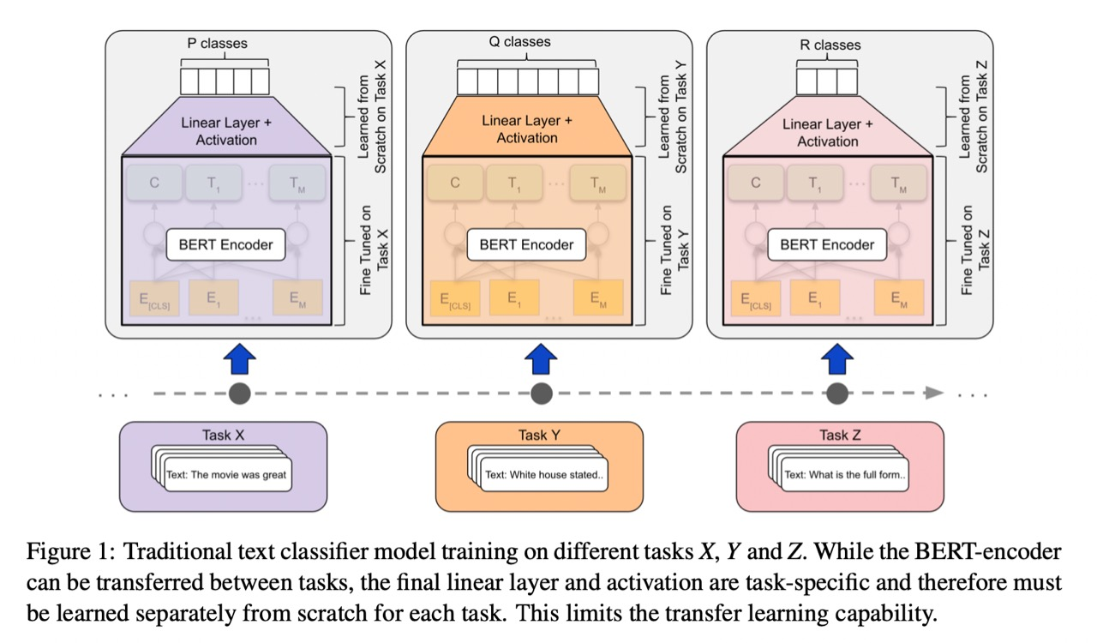
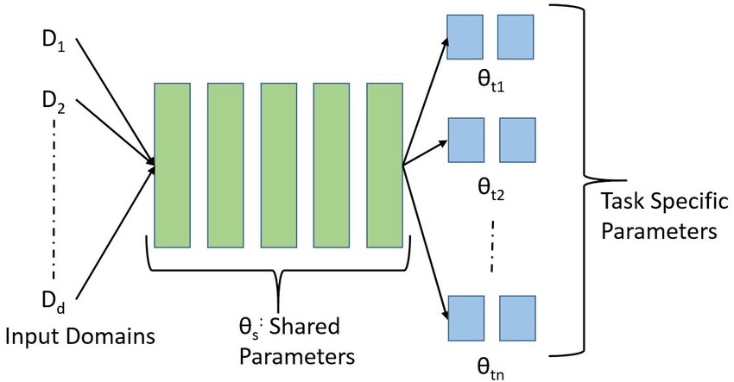
Analogy
Definitions
?
Can we use transfer learning with new tasks without retraining?
Same Model
Transfer Learning
?
Can we use one Solution to tackle many tasks?
a subfield of machine learning in which multiple learning tasks are solved at the same time, while exploiting commonalities and differences across tasks. This can result in improved learning efficiency and prediction accuracy for the task-specific models (Wiki)
?
How we can deal with lack of data?
Is it possible to build classifier for non observed class, zero-sample for each class?
?
Yes
Can we add new classes without retrain the model, and classify them successfully ?
?
Is it possible to build classification task for just few examples of each class?
?
Multi Tasking Learning
transfer the stored knowledge gained while solving one problem and applying it to a different but related problem.(Wiki)
Task-Aware Representation of Sentences for Generic Text Classification
TARS
Few Shot Learning
Few Shot Learning
Multi Tasking Learning
Generic Symantec Representation
is the problem of making predictions based on a limited number of samples, so it's just an elaboration name that shows the number of samples per each class you have e.g (zero-shot, one-shot and n-shot learning) .(Wiki)
data scarcity

Slide 4
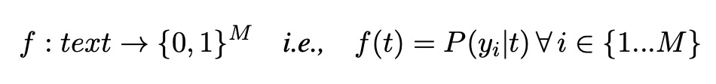
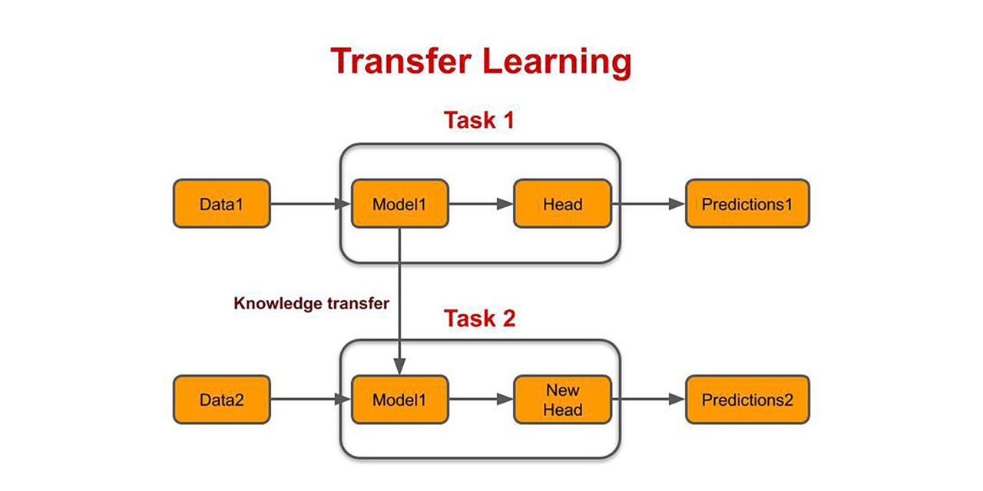
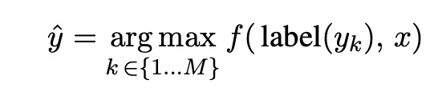
Challenges with Transfer Learning
Solution
1
Retraining the top layers with new tasks
They formulate text classification as a universal binary classification problem and use cross-attention to capture the modified objective.
Input
output
"I enjoyed the movie a lot”
“I heated the movie a lot"
→ positive sentiment
→ negative sentiment
2
Ignoring the information provided by labels.
3
Not working with significantly different domains.
Input
output
("sports “ ,“Mohamed Salah signs new three-year contract at Liverpool” )
("politics “ ,“Ukraine weapons: What military equipment is the world giving?”)
→ T/F
→ T/F
multi-class problems they use the class with maximum confidence (for True) as the final prediction

Slide 5
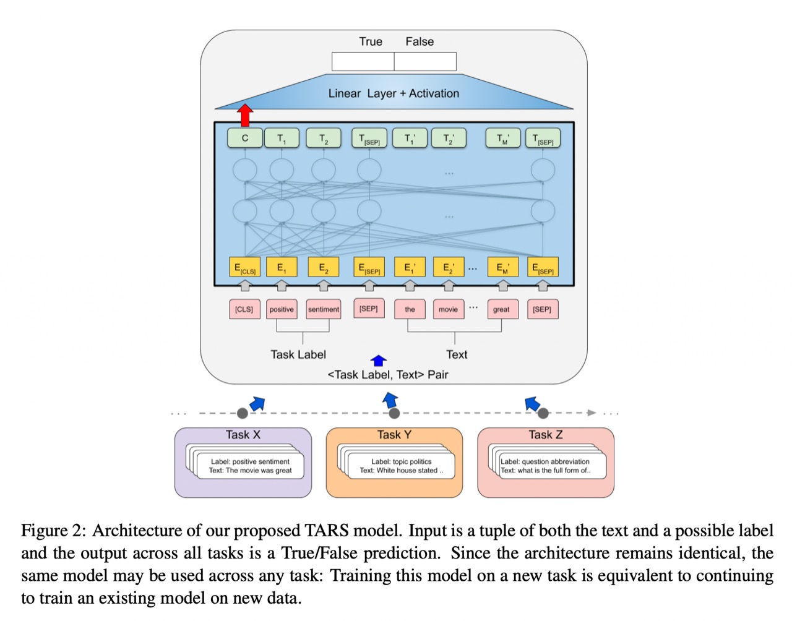
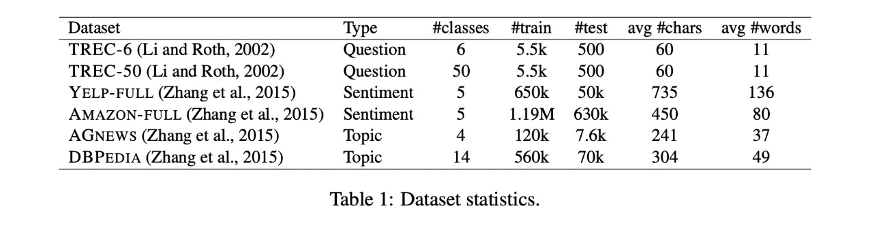
Aarchitecture and Dataset
1
Bert-encoder (Transformer).
2
Cross attention between text and label.
3
They have done experiment with 6 widely-used text classification datasets that span different textual domains and classification tasks.
4
Two datasets for the task of topic detection, Two datasets for Sentiment Analysis and two classifying question types.

Slide 6
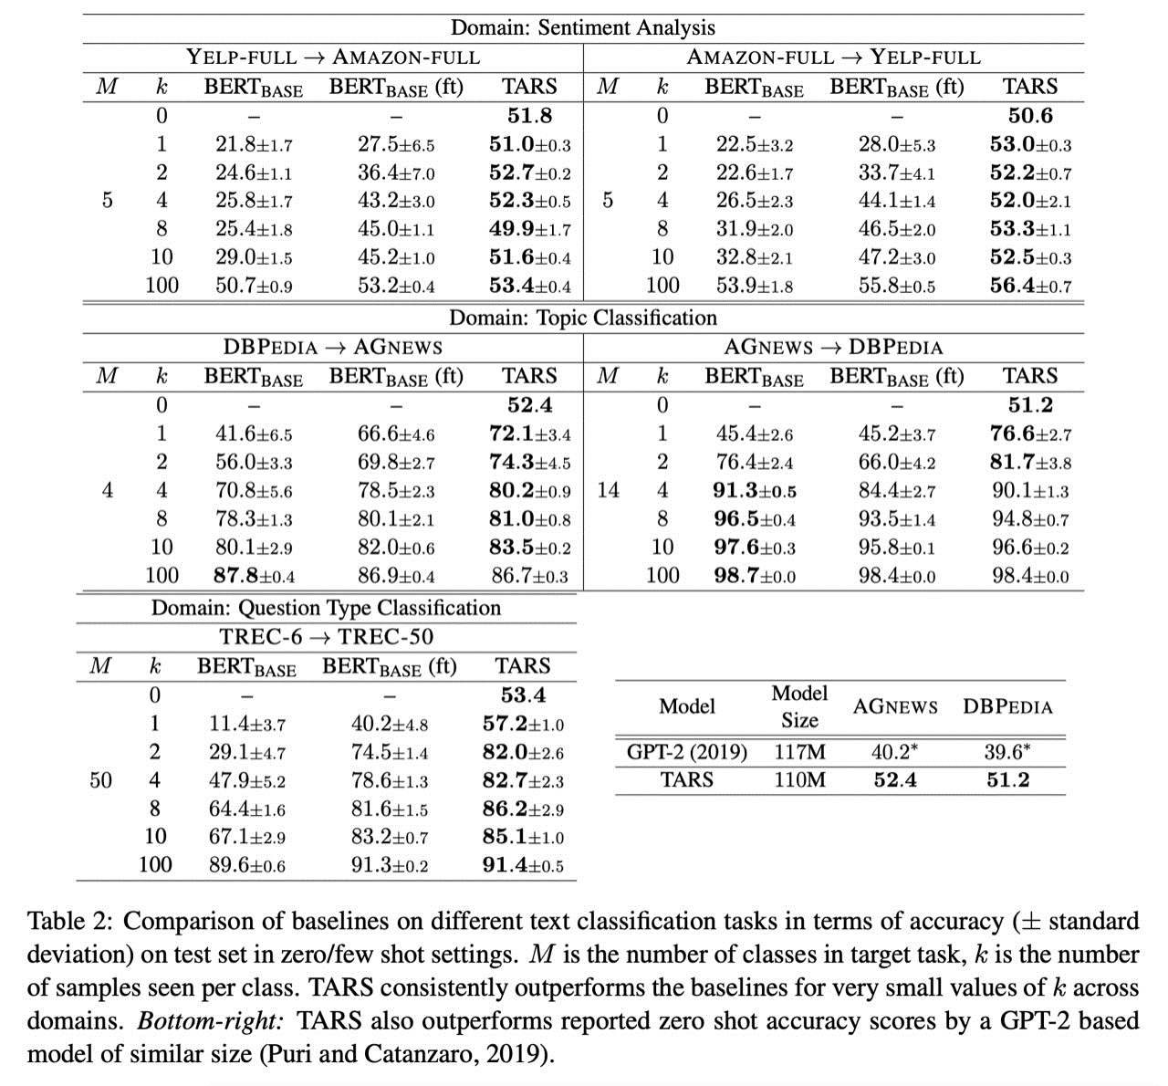
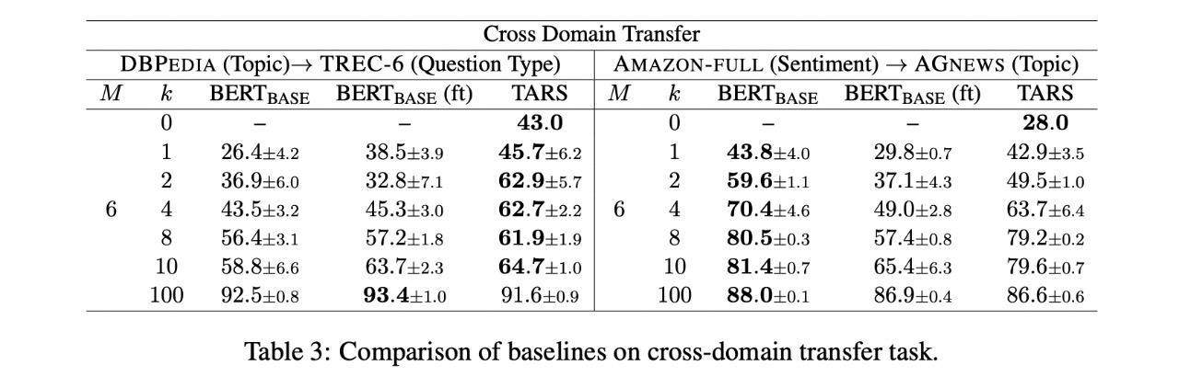
Results
Same Domain
Cross Domain

Slide 7
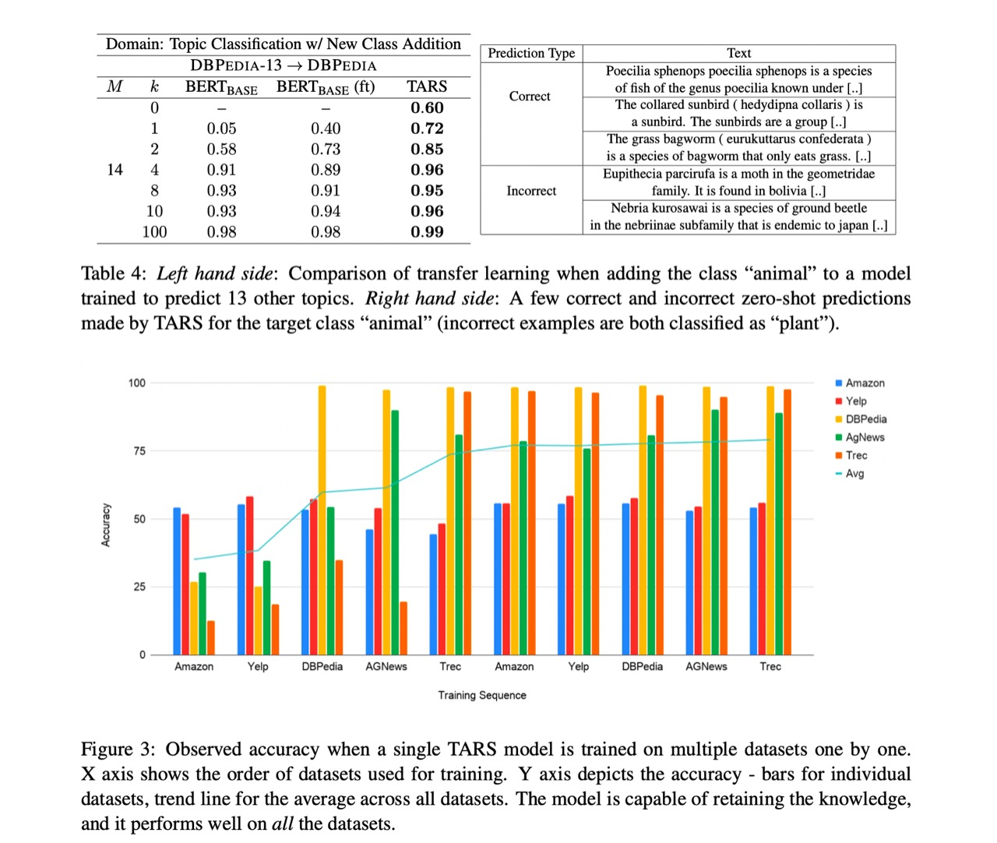
Results
Adding new Class that not exist on the training data

Slide 8
Conclusion and future Work
They addressed key shortcomings of the existing transfer learning mechanisms for text classification and proposed a novel formulation that transforms it into a generic binary classification problem.
The proposed TARS architecture captures the similarity between an input text and the task label to per- form text classification.
They showed that TARS is capable of making zero-shot predictions in multiple text classification tasks, and adapts to a new do- main faster than competitive baseline models in few-shot learning settings
The proposed model also generalizes the text classification task to the extent that a single model can perform well on multiple text classification tasks simultaneously.
- optimizing the computational complexity of TARS
- reducing computational complexity is by exploring architectural choices of transformer encoder. e.g. using complementary lighter transformer encoders, or applying model pruning

Slide 9
References
https://aclanthology.org/2020.coling-main.285.pdf
https://joeddav.github.io/blog/2020/05/29/ZSL.html
https://github.com/flairNLP/flair

Slide 10
Thank You
DECORATIVE ELEMENTS
DROP SHADOW
BASE LINE
SWASH

Slide 11
Any Question?
TARS

